Slide 1

Apollo Conceptual Architecture
Marc Brasoveanu (Presenter), Andrew Wilker, Nathan Perriman, Theo Raptis (Presenter)
Video Link: https://youtu.be/wrzigNbKpHk

Slide 2
Group Roles
Marc Brasoveanu Abstract, Introduction, Derivation Process, Conclusion, ½ Slides and Presentation
Andrew Wilker Group Leader, Use Cases, Sequence Diagrams, Box-and-line diagrams
Nathan Perriman Concurrency, Subsystems
Theo Raptis Architectural Style, External Interfaces, Limitations, ½ Slides and Presentation

Slide 3
Introduction
Autonomous driving open source library
Focus on Apollo Cyber RT
Presentation Covers
Architectural Style
Concurrency
Subsystems
External Interfaces
Use Cases (with sequence diagrams)

Slide 4
Derivation Process
Gather resources
Analyze the subsystems
Resolve dependencies
Model architecture with sequence diagrams

Slide 5

Architectural Styles
Layered Architecture
Publish-Subscribe Architecture
Use of “talkers” and “listeners”
Process Control Architecture

Slide 6
Concurrency
Modules can run independent of each other through the use of publish-subscribe style
Process control style allows Controller to make changes in real time to movement parameters
StoryTelling Module prepares vehicle for future complex scenarios
Monitor and Guardian modules determine status of system in motion

Slide 7
Subsystems
Perception Prediction Routing Planning Control CanBus | Localization DreamView Monitor Guardian Storytelling

Slide 8
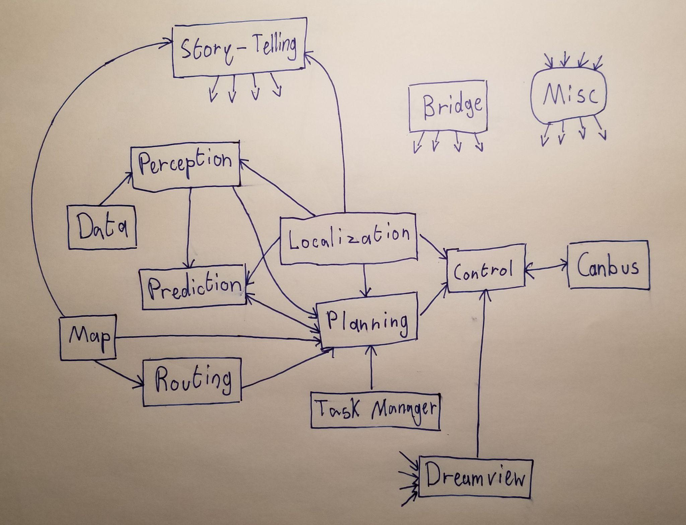
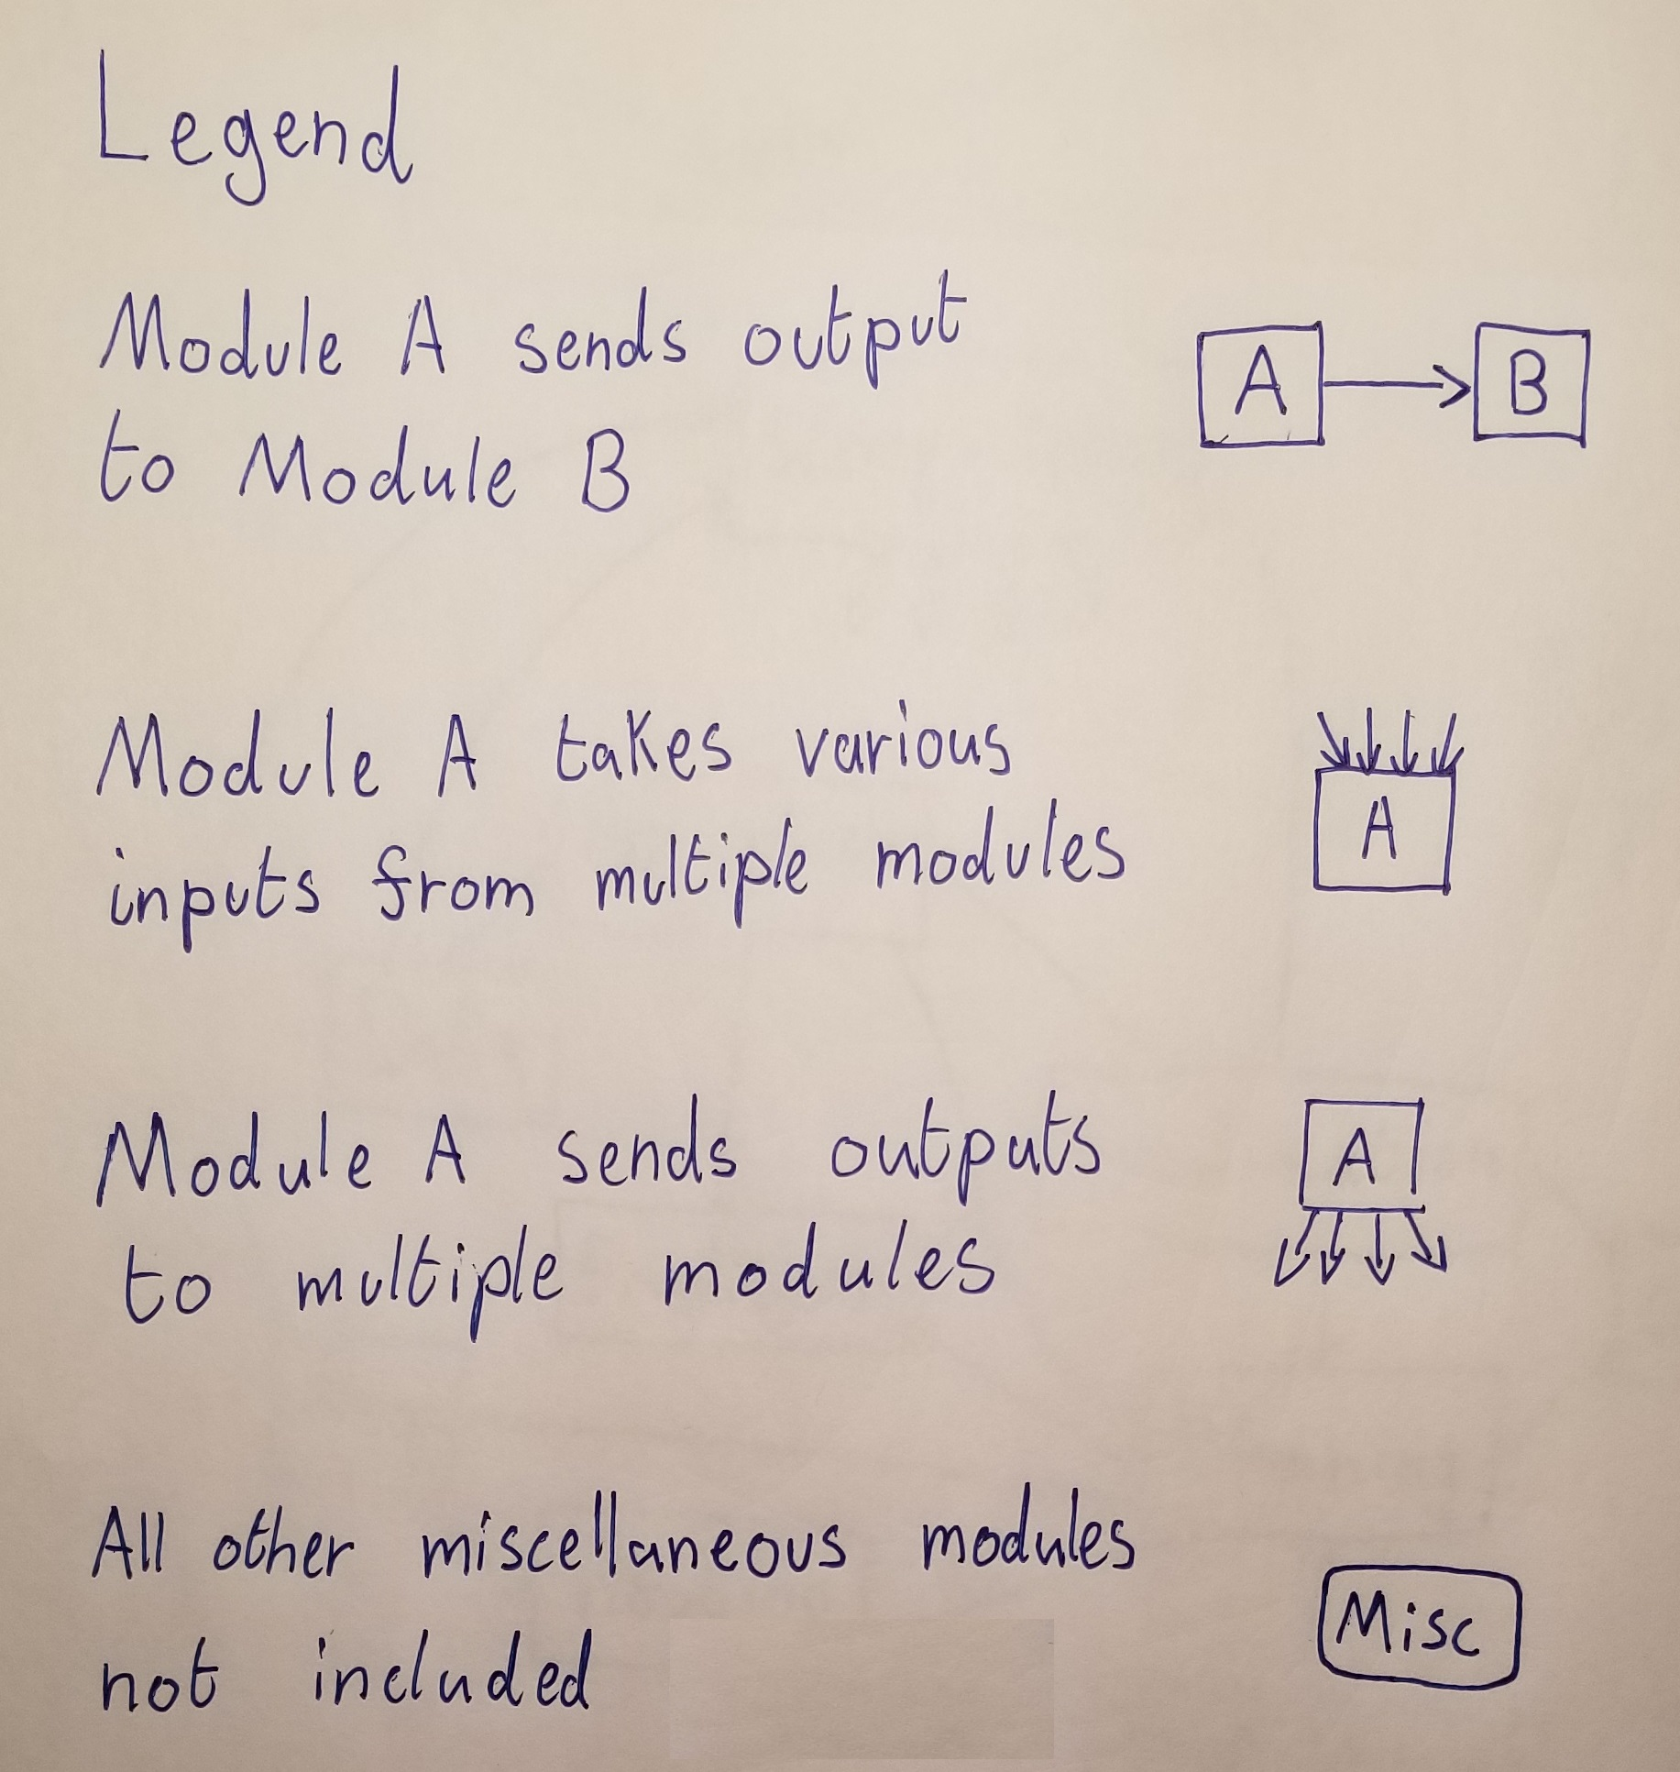
Subsystems

Slide 9
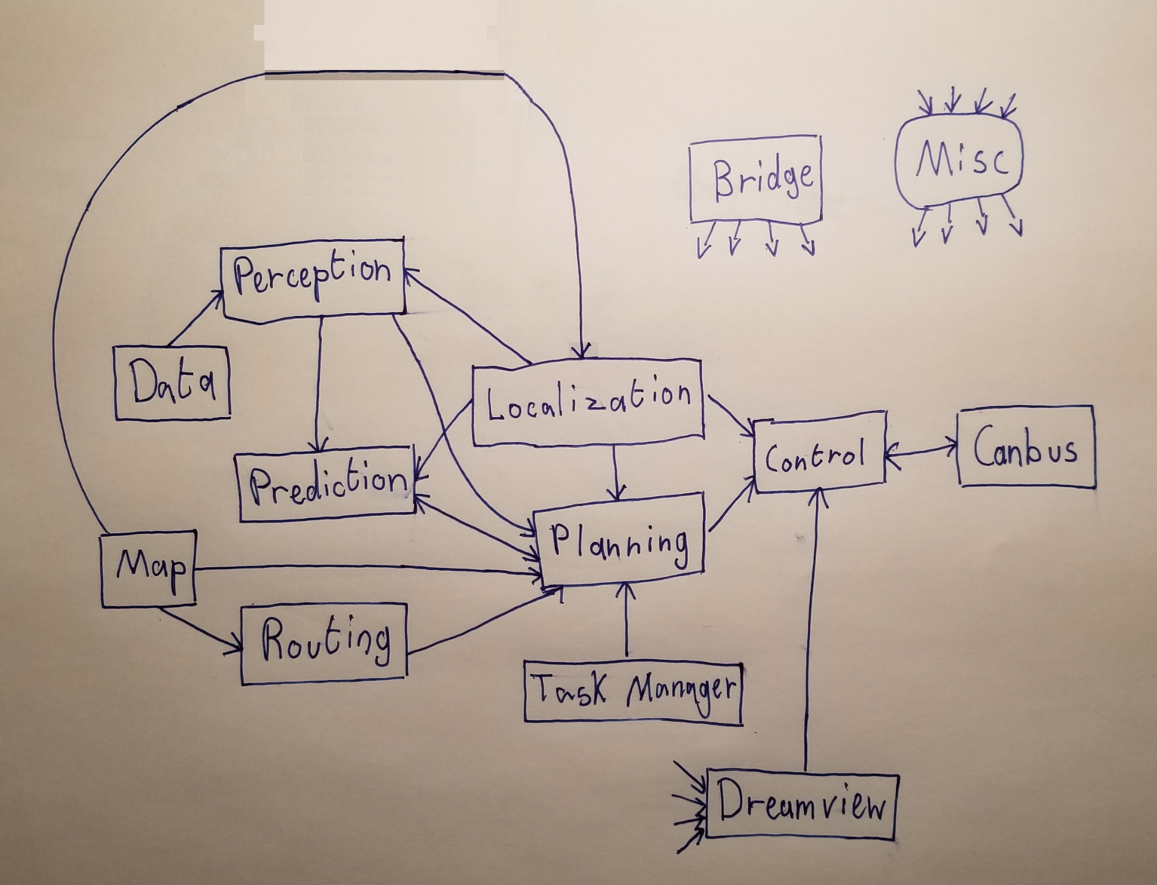
Alternative Architecture

Slide 10
External Interfaces
Breakdown by modules
Information In
Perception
Routing
Localization
CanBus
Information Out
Human Machine Interface (HMI)

Slide 11
Use Cases
Two use cases
Automobile drives the user to a destination
Automobile parks itself

Slide 12
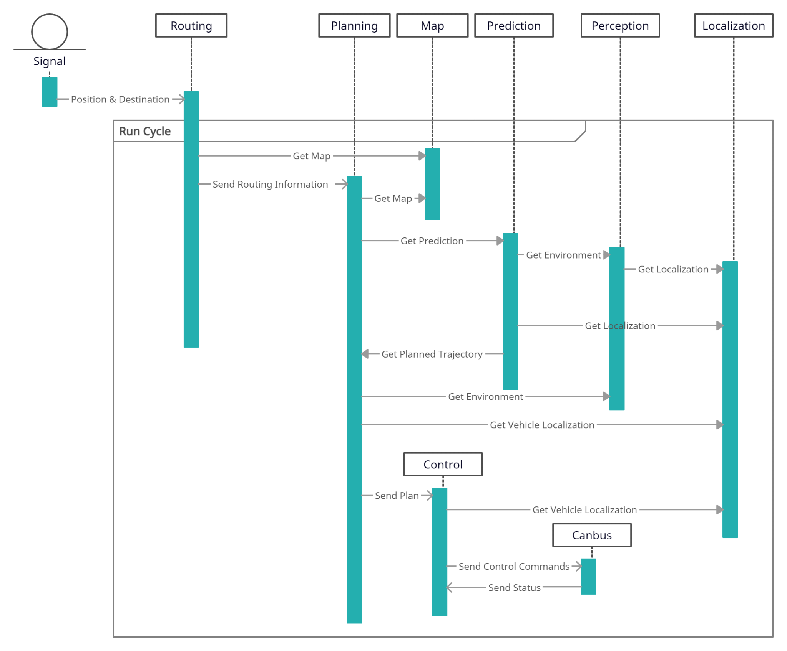
Sequence Diagram - Use Case 1

Slide 13
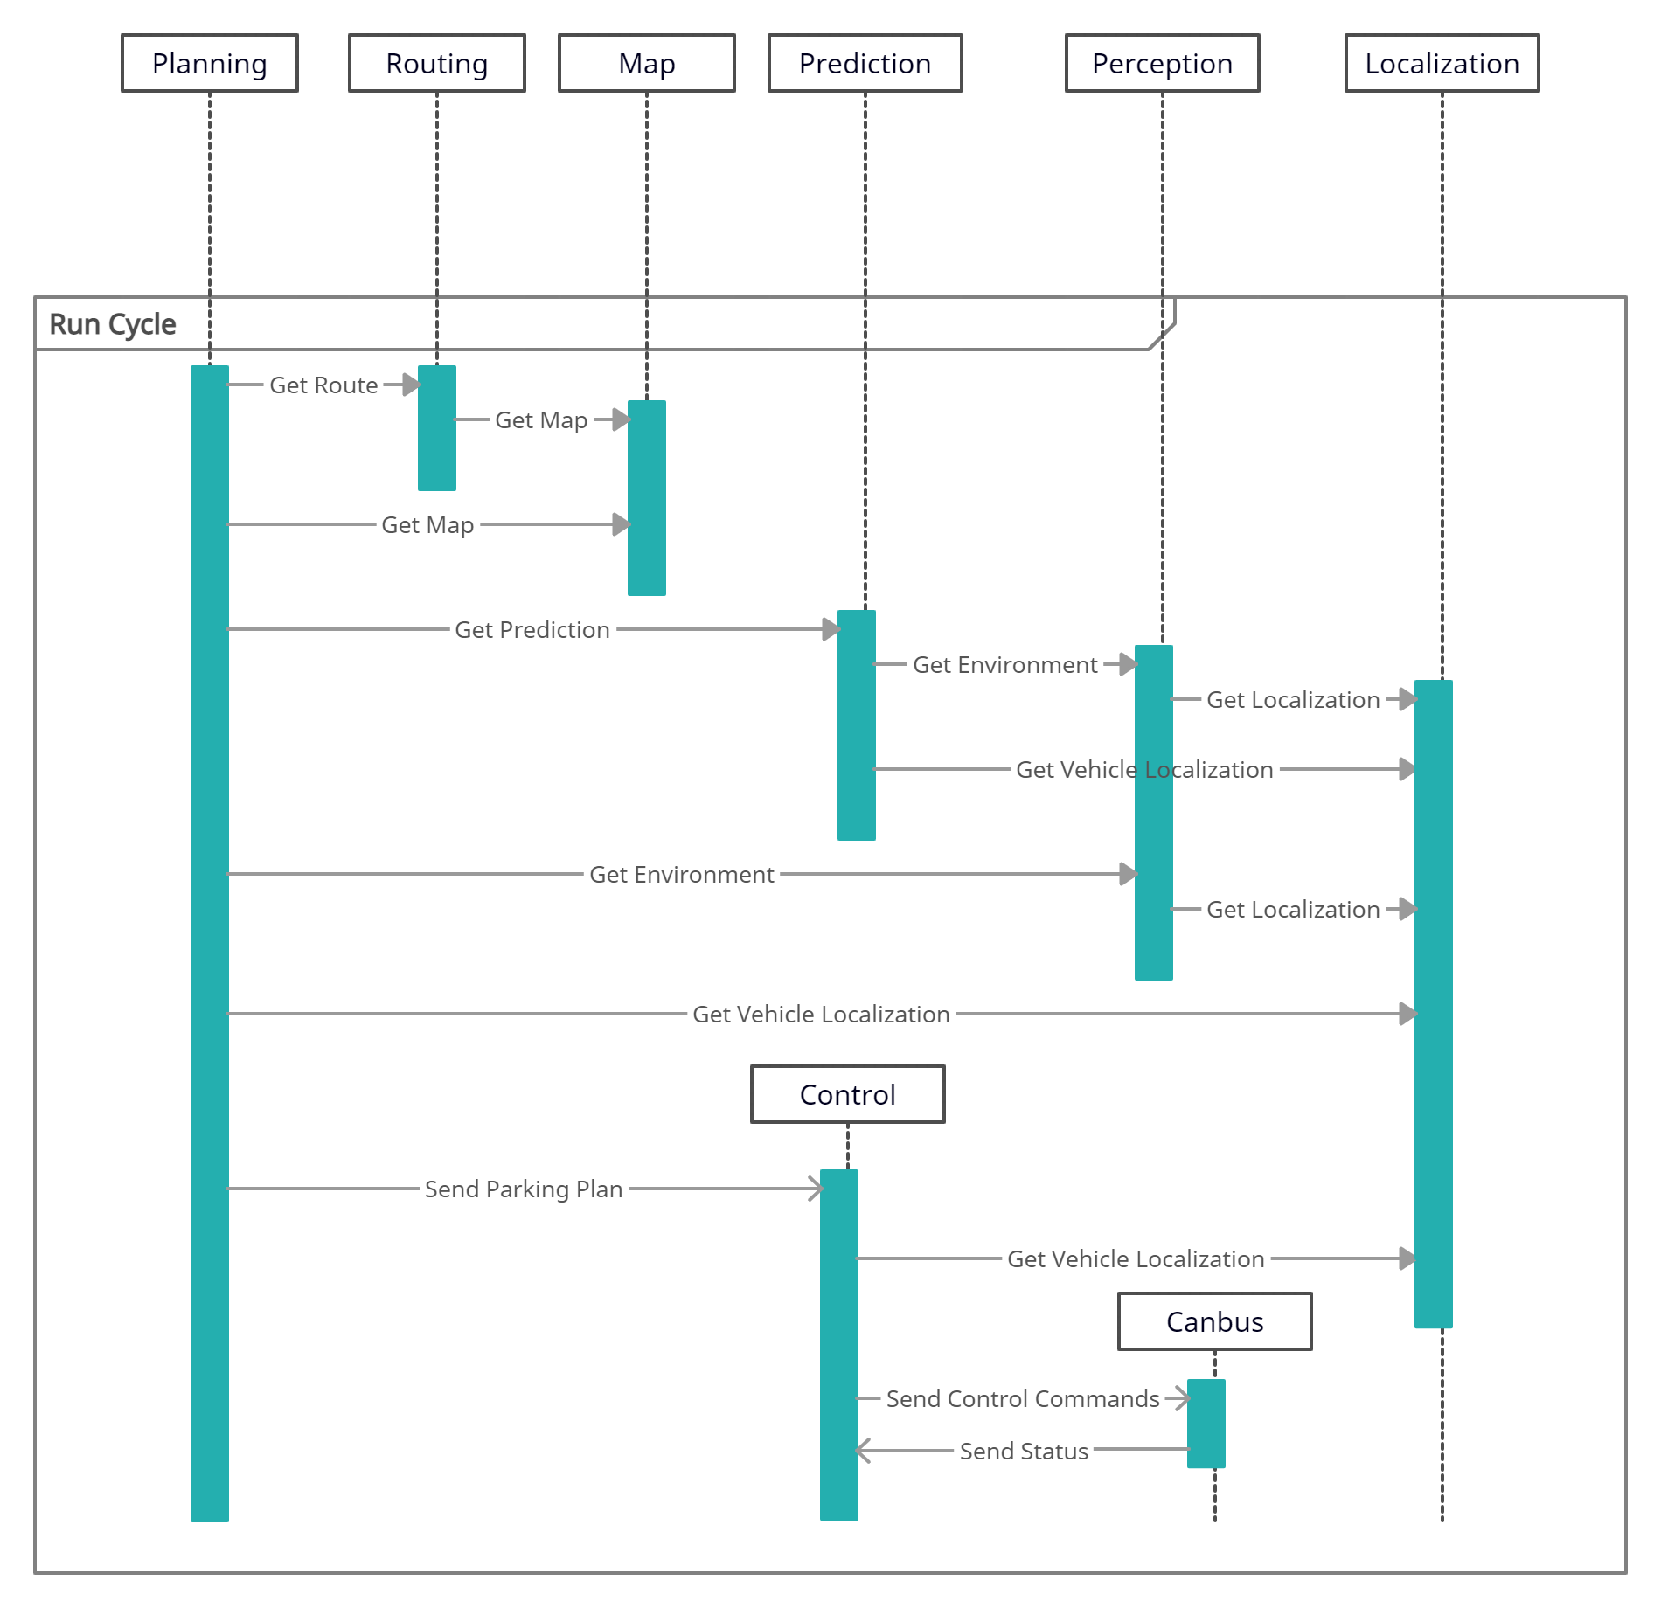
Sequence Diagram - Use Case 2

Slide 14
Limitations & Lessons Learned
Limitations
Group has only 4 members
Documentation limitations
Limited prior experience with autonomous driving domain
Lessons Learned
Potential for group to be more productive in future
Enhanced understanding of conceptual architecture in theory and in practice
First look at autonomous driving domain

Slide 15
Conclusion
Architectural style features layered, publish-subscribe and process control design patterns
High degree of concurrency
Depends on several subsystems for correct operation
Various modules which ingest and transmit information
Two main use-cases
Automobile drives user to destination
Automobile parks itself
Report suffered from some limitations, but many lessons were learned
Experience will be beneficial for next assignment

